Slide 1
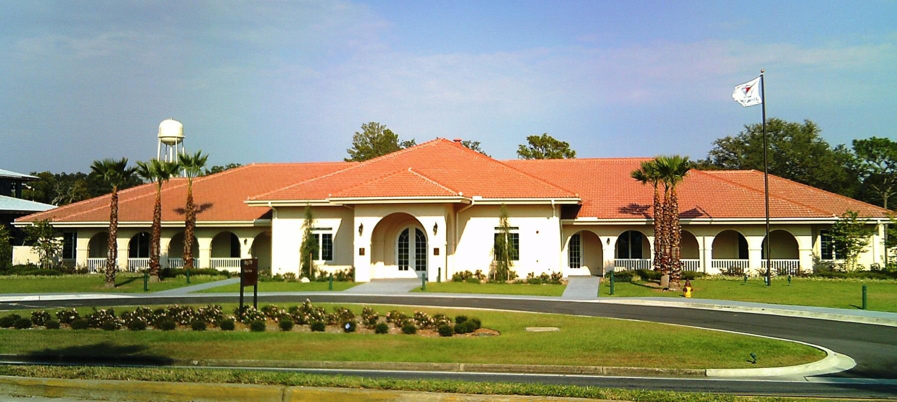
Fisher House
of the Emerald Coast, Inc
Located directly across the street from Eglin AFB Hospital
and a short distance from the VA Clinic
To provide needed resources for military families in crisis and also to enable these families to stay together when a member is being treated in the local area.

Slide 2
WHAT IS THE FISHER HOUSE?
A comfort home, donated by Fisher House Foundation so that members of the military and their families may be together at the most stressful time – during the hospitalization for an unexpected illness, disease or injury.
There is at least one Fisher House at every major medical center to provide families with the comforts of home in a supportive environment.

Slide 3
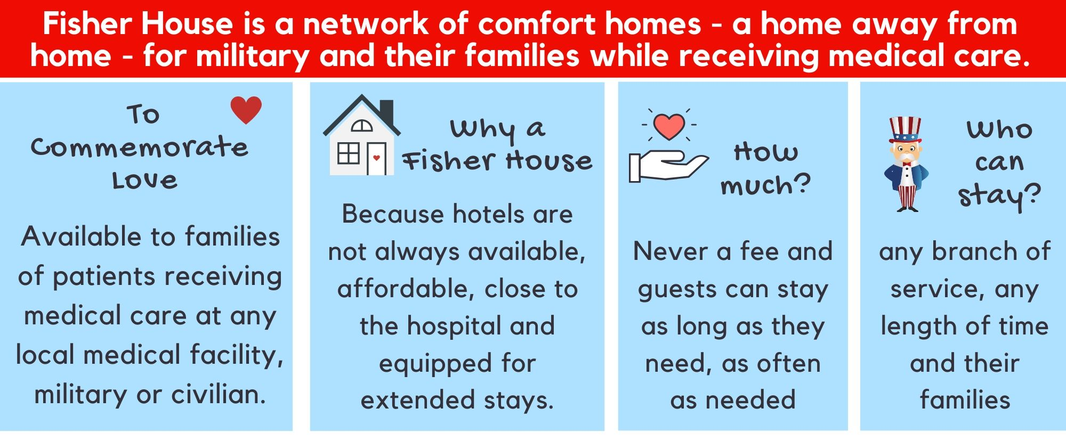
What, Why, How Much and Who

Slide 4
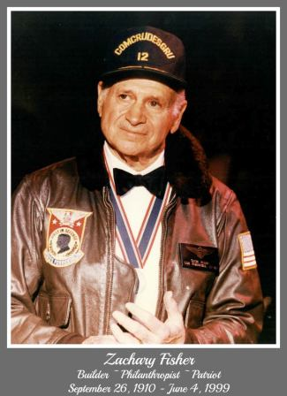
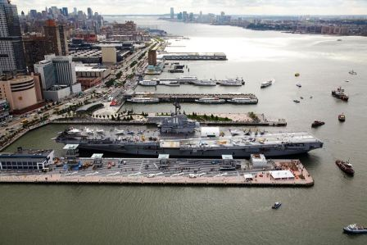
Zachary Fisher

Slide 5
About Fisher House Foundation
Zachary and Elizabeth Fisher of New York founded the Fisher House Foundation, Inc with the intention of meeting a humanitarian need for our nation’s hospitalized military personnel, veterans and their families.
335,000 families served since 1990
$407 Million + in savings to families since 1990
8 Million Days of lodging
Our Fisher House hosted 1,000 guests in 2019 (300 families loved) and have saved military families almost $1.9 million since our opening in 2010. We were #48.

Slide 6
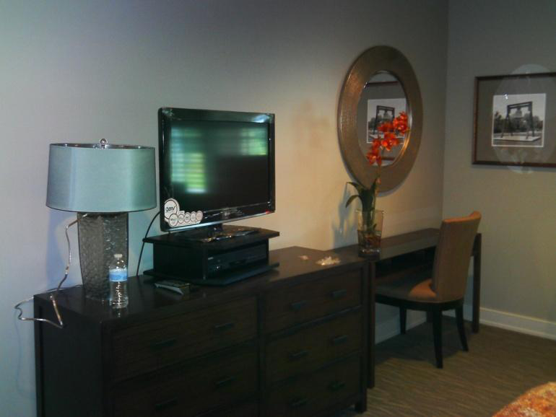
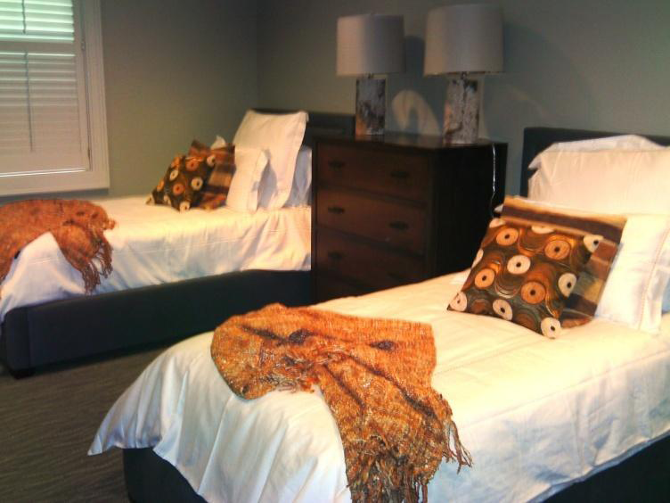
Fisher House
of the Emerald Coast
Commitment to 5 Star Quality, $80,000 furniture replacement in 2018, $80,000 exterior improvements in 2019

Slide 7
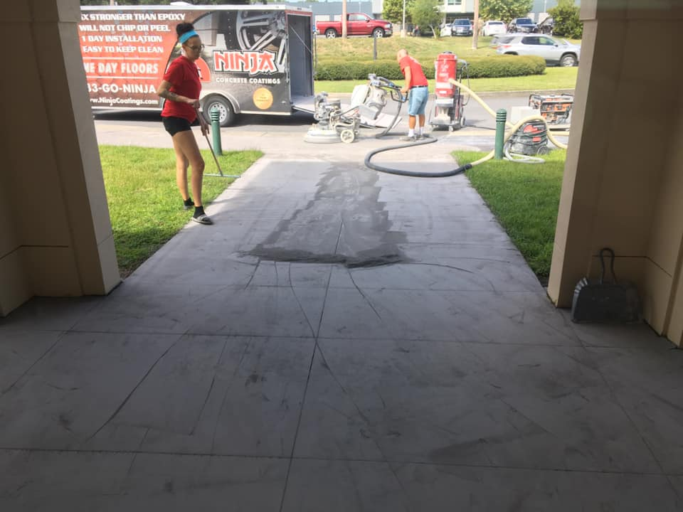
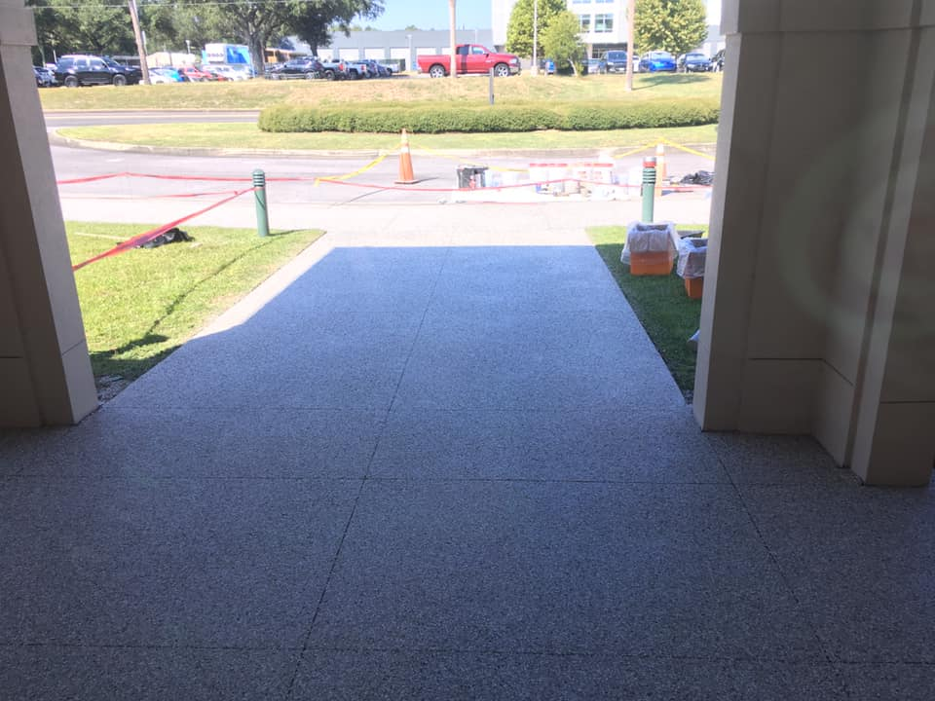
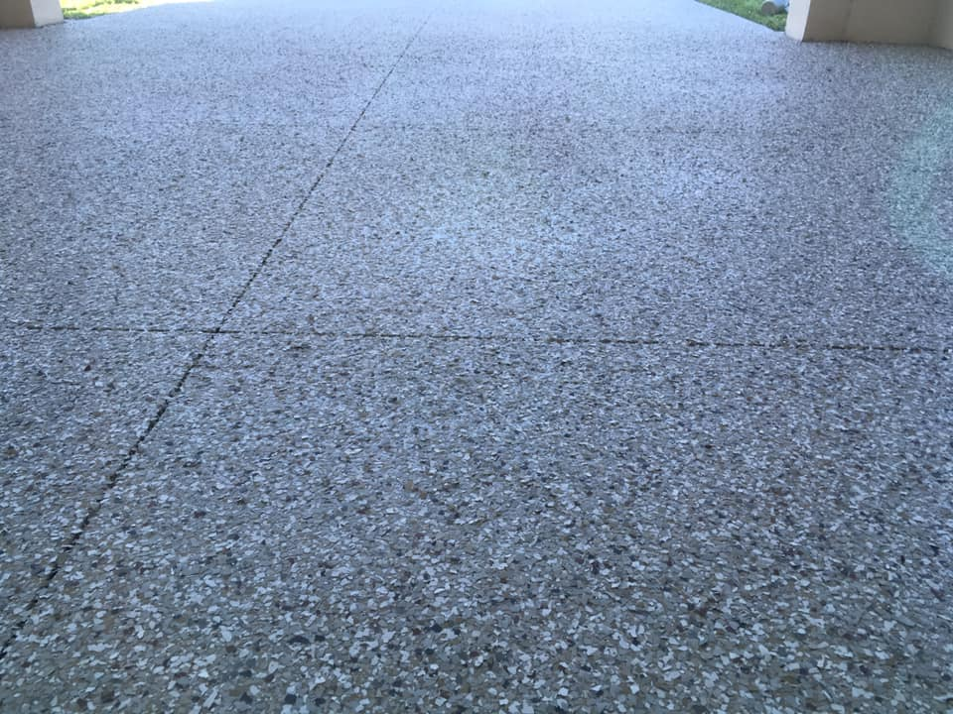
Fisher House
of the Emerald Coast
Before = UGLY
i.e., We can do a lot better for you!
After = WOW
Surfaces are lovely, slip resistant, wheelchair and cane friendly, now ADA compliant. Who gets excited over concrete??? ME!

Slide 8
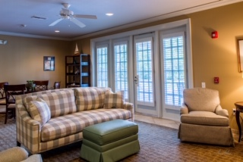
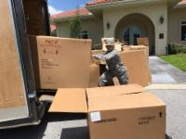
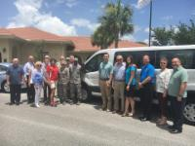
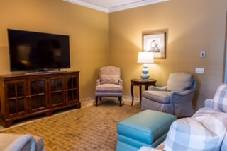
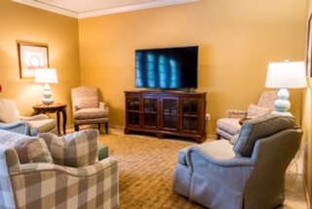
Furniture arrives…..

Slide 9
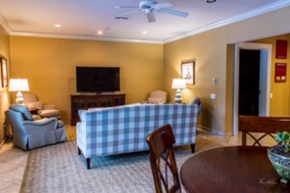
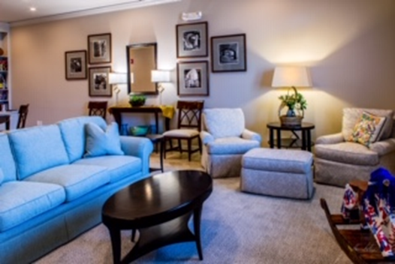
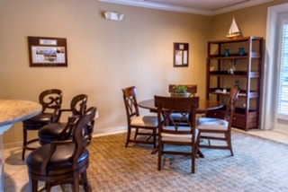
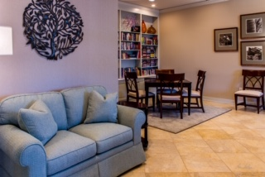
Check out 5-Star Wow

Slide 10
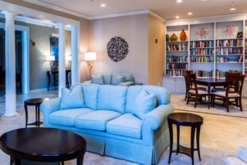
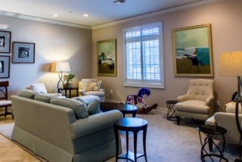
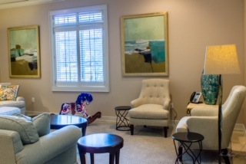
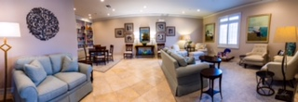
All for you and your family

Slide 11
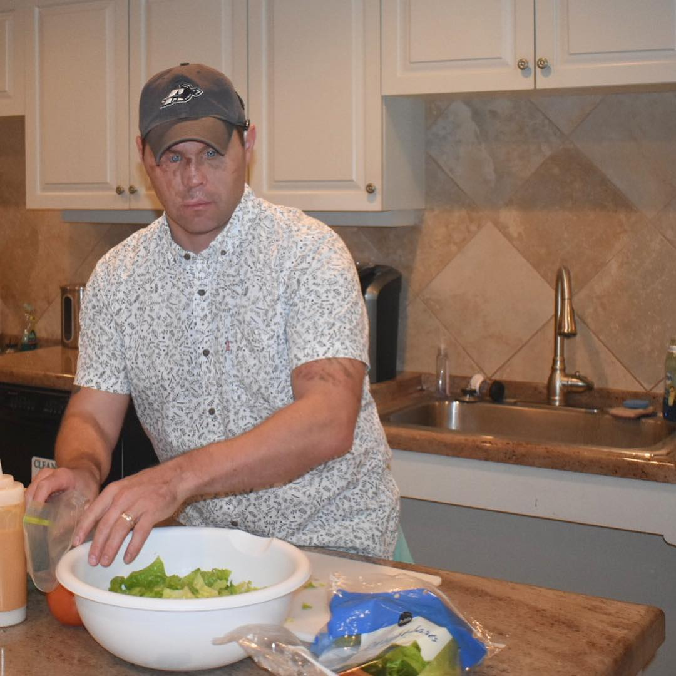
Random Facts
Average length of stay: 3 days
Longest stay at our House has been 13 months (oncology), next 11 months (Aaron Hale)

Slide 12
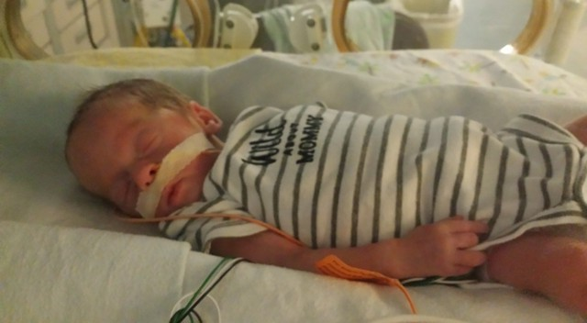
Meet our families = the impact of your care
We pay for hotels when care takes you out of reach of our house at Eglin.
Baby Asher, born at 26 weeks gestation

Slide 13
Meet our families = the impact of your care

Slide 14
Meet our families = the impact of your care

Slide 15
How Can You Help?
VOLUNTEER – prepare a meal for our guests, help with an event
Bake Cookies first Wednesday of every month
Be a NATIONAL DAY CHAMPION, i.e., National Popcorn Day, Blueberry Pancake Day, etc.
Be a DOT CONNECTOR and share our message.
VOLUNTEER – PARTNER – SHARE

Slide 16
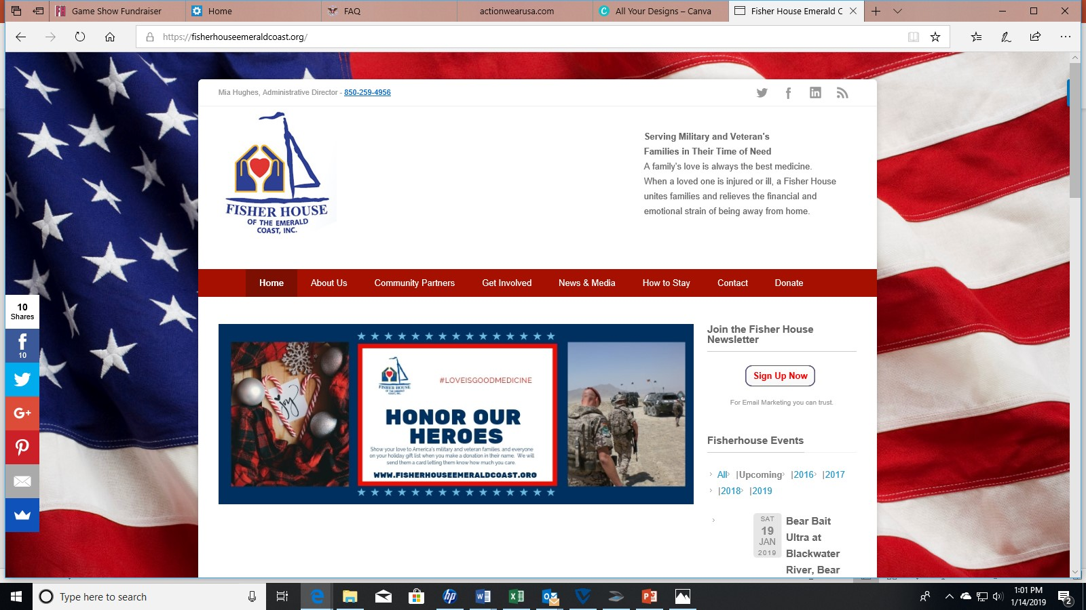
Just like Krispy Kreme, our website is HOT NOW!
WWW.FISHERHOUSEEMERALDCOAST.ORG
Text
FHEC to 22828 to connect

Slide 17
Connect with us

Slide 18
Contact information
Fisher House of the Emerald Coast
P.O. Box 2007, Eglin AFB 32542
Telephone: 850-259-4956
director@FisherHouseEmeraldCoast.org
www.FisherHouseEmeraldCoast.org

